Slide 1


Electronic aids to cessation (SMS, apps and websites)
Felix Naughton
Behavioural Science Group
University of Cambridge
fmen2@medschl.cam.ac.uk
Division of Primary Care
University of Nottingham

Slide 2
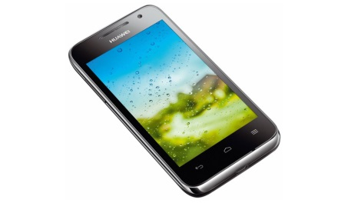
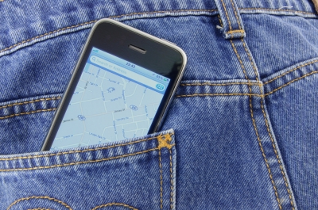

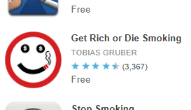
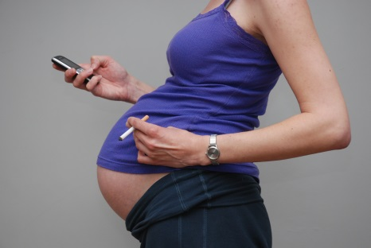

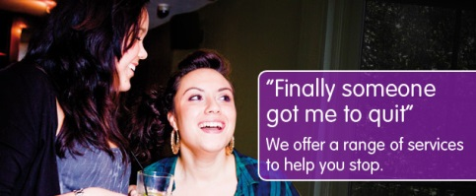



Why digital interventions?
£££££
WIDE REACH

Slide 3

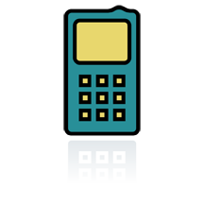
Do smokers have access/capability?
Brown et al (2013) JMIR
Brown et al (2013) JMIR; NIHR Programme, unpublished

Slide 4
Are smokers interested in digital support?
Non-pregnant smokers
Brown et al (2013) JMIR; Westmaas et al (2011) JMIR
Pregnant smokers (N=488)
NIHR Programme, unpublished

Slide 5
Are smokers interested in digital support?
Non-pregnant smokers (N=1,128)
Brown et al (2013) JMIR
Pregnant smokers (N=488)
NIHR Programme, unpublished

Slide 6
Are digital cessation interventions effective?
    Over 80% of US cessation websites provided no coverage of key components of US tobacco treatment guidelines (Bock et al, 2004)
    Assessing effectiveness of web/internet interventions is complex
      Interventions vary widely and often include additional components
      Comparison arms vary widely
      Low intervention usage common

Slide 7
Are digital cessation interventions effective?
    Conclusions from reviews of web/internet interventions
    Some evidence of effectiveness of web/internet programmes compared to control interventions (adults)
    Myung et al (2009) Arch Intern Med; Hutton et al (2011) Nic Tob Res
    Tailored interactive programmes more effective than non-tailored/non-web/non-internet based programmes (adults)
    Shahab & McEwen (2009) Addiction; Civljak et al (2010) Cochrane Database Syst Rev
    Insufficient evidence that web/internet programmes more effective than behavioural support/counselling or adds benefit
    Shahab & McEwen (2009) Addiction; Hutton et al (2011) Nic Tob Res

Slide 8
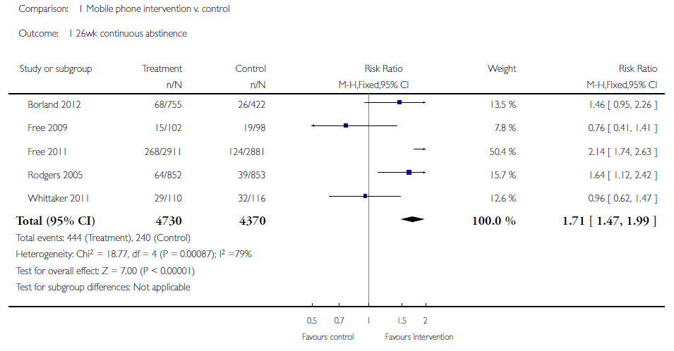
Are digital cessation interventions effective?
    SMS text messaging
Whittaker et al (2012) Cochrane Database Syst Rev

Slide 9

Are digital cessation interventions effective?
    SMS text messaging – among pregnant smokers (N=207)
OR = 1.7 [0.7 – 4.3]
Naughton et al (2012) Nic Tob Res

Slide 10

Are digital cessation interventions effective?
    SMS text messaging – benefit on top of level 2 advice (N=602)
OR = 1.2 (95% CI 0.9-1.7)
OR = 1.2 (95% CI 0.8-1.8)
Protocol – Sutton et al (2013) BMC Public Health

Slide 11
Are digital cessation interventions effective?
    SMS text messaging – benefit on top of level 2 advice (N=602)
OR = 1.8 (95% CI 1.1-3.0)
Protocol – Sutton et al (2013) BMC Public Health

Slide 12
Are digital cessation interventions effective?
    Apps – popular cessation app adherence to US Clinical Practice Guidelines (iPhone & Android)
    Abroms et al (unpublished) – update of Abroms et al (2011) Am J Prev Med
App types (N=98)
Calculator (38.8%)
Hypnosis (17.3%)
Rationing (15.3%)
Tracker (12.2%)
Informational (6.1%)
Other (10.3%)
Adherence to guidelines (out of 42) – mean = 12.9
Informational (15.6)
Calculator (14.8)
Hypnosis (13.1)
Rationing (12.0)
Tracker (11.5)
Other (6.5)

Slide 13
Are digital cessation interventions effective?
    Apps – popular cessation app adherence to US Clinical Practice Guidelines (iPhone & Android)
    Abroms et al (unpublished) – update of Abroms et al (2011) Am J Prev Med
19% gave advice on how to quit/stay quit
App types (N=98)
Calculator (38.8%)
Hypnosis (17.3%)
Rationing (15.3%)
Tracker (12.2%)
Informational (6.1%)
Other (10.3%)
Adherence to guidelines (out of 42) – mean = 12.9
Informational (15.6)
Calculator (14.8)
Hypnosis (13.1)
Rationing (12.0)
Tracker (11.5)
Other (6.5)
Only 5% mentioned medications
None recommended calling a Quitline

Slide 14
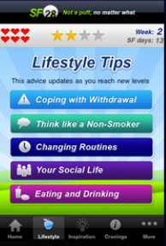
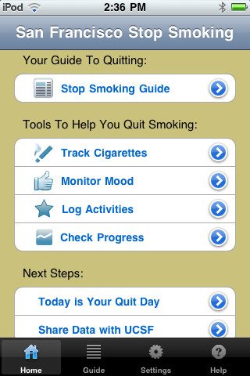
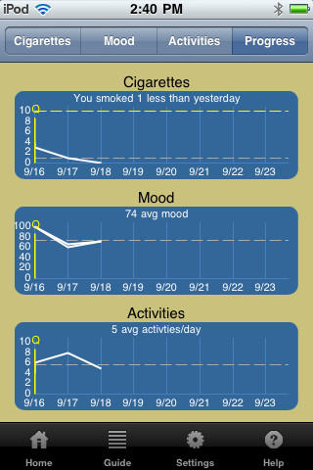
Evidence based apps

Slide 15


How might digital cessation interventions work?
    Associated with increased use of medications?
    Associated with increases in self-efficacy?
    - Exposure associated with abstinence
    Shahab & McEwen (2009); Hutton et al (2011)
    Increasing exposure
    McClure et al (2013) JMIR; Crutzen et al (2012) JMIR
    Engagement
    Pages visited
    Time on website
    Knowledge
    Prescriptive tone
    Tunnelling (dictating content viewing order)
    Reminder emails

Slide 16

How might digital cessation interventions work?
    SMS Associated with increased use of medications/support
    Associated with increases in self-efficacy (pregnancy)?
    Associated with setting a quit date (pregnancy)?
    Naughton et al (2012); iQuit in Practice (unpublished)
    Apps

Slide 17


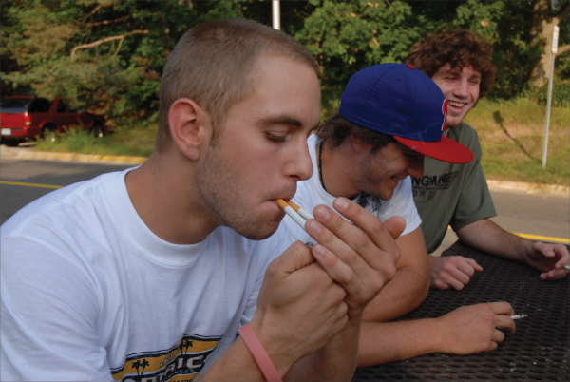
Where are we when smokers face triggers?

Slide 18
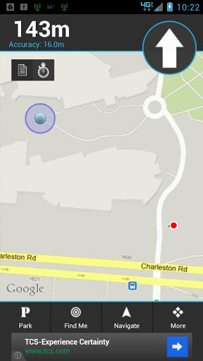
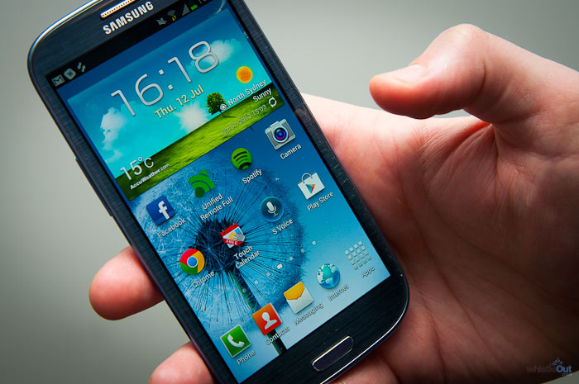
‘Just in time’ support (system-triggered)
Mobile sensing
  Sensors on smartphones can be used by systems/apps to identify high risk situations and trigger support
Naughton & Sutton (2011) Eur Health Psych

Slide 19
Conclusions
Reasonable interest in digital cessation aids + likely to grow
Some evidence that web/internet interventions can increase quitting, but studies are fairly heterogeneous
Stronger evidence for SMS compared to minimal intervention
No evaluation trials for apps yet – most on the market do not adhere strongly to clinical guidelines
Apps have potential to deliver real-time support tailored to real-time events…watch this [virtual] space

Slide 20
Thank you
‘This presentation presents independent research funded by the National Institute for Health Research (NIHR) under its Programme Grants for Applied Research Programme (Grant Reference Number RP-PG 0109-10020). The views expressed in this presentation are those of the authors and not necessarily those of the NHS, the NIHR or the Department of Health.’
Thanks to colleagues:
Stephen Sutton
Tim Coleman
Andy McEwen
Sue Cooper
Michael Ussher
Jo Leonardi-Bee
Kate Pickett
Sophie Orton
Katharine Bowker
Hazel Gilbert
A. Toby Prevost
James Jamison
Sue Boase
Melanie Sloan
James Brimicoombe
Dan Mason
Felix Naughton
Behavioural Science Group
University of Cambridge
fmen2@medschl.cam.ac.uk

